Slide 1
Evidential Classification/Regression
Apostolos Psaros
Feb 5 2021
Sensoy, M., Kaplan, L. and Kandemir, M., 2018
Evidential deep learning to quantify classification uncertainty
NeurIPS 2018.
Amini, A., Schwarting, W., Soleimany, A. and Rus, D., 2020
Deep evidential regression
NeurIPS 2020.
Bishop, C.M., 2006
Pattern recognition and machine learning
Springer.

Slide 2
Introduction
Classification
y(x): class assignment for sample x
NN output: vector of discrete class probabilities (e.g., [0.2, 0.7, 0.1])
Prediction: class corresponding to max probability
Regression
y(x): continuous variable for location x
NN output: mean of y(x)
Prediction: NN output
Standard training
Provides a point estimate: no epistemic uncertainty
Can the predictor simply say “I do not know”?
Bayesian framework
Provides samples from the posterior: We can average different predictions
Epistemic uncertainty associated with different posterior samples
Evidential framework
A single NN forward pass outputs mean & epistemic uncertainty
Notes:
Let me start with a brief introduction. If something is not clear here in the introduction, don’t worry I will explain all these in detail later.
Both classification and regression in their standard forms are supervised learning problems and thus we have input-output pairs, x and y, and we aim to create a map from x to y.
In classification, y(x) is the class assignment for the sample x, and the NN output is a vector of discrete probabilities, say a vector [0.2, 0.7, 0.1].
This means 20 percent probability for x to belong to the first class and so on and so forth.
Based on the NN output, we make a prediction for the class assignment which typically is the class corresponding to the maximum probability. So here it would be class 2.
For regression, y(x) is a continuous variable corresponding to the location x and we typically model the mean y(x) with a NN.
In this regard, standard optimization of the NN in both cases provides a point estimate, that is a single set of optimal NN parameters and a single vector of probabilities for classification and also a single mean value of y(x) for regression. Ideally, however, we would also like the predictor to be able to respond I do not know if it cannot confidently make a prediction.
To this aim, we may use the Bayesian framework. We use many different parameter sets for the NN, we perform multiple forward passes, and thus have many predictions which we can then average for example. Or we can take their variance or compute other statistics. So epistemic uncertainty is provided through different samples from the posterior. Just to clarify, epistemic uncertainty refers to the fact that the available data may not be enough to fully specify the NN parameters and in effect its prediction.
The evidential framework provides a completely different approach. As you will see in the presentation, with a single optimization trajectory and without relying to sampling we can have an estimate for both the mean response but also epistemic uncertainty with a single forward pass.

Slide 3
Presentation outline
Parameter estimation
Bernoulli/Categorical distribution Classification
Gaussian distribution Regression
Bayesian inference
Prior/Posterior predictive distributions
Classification/Regression
Bayesian treatment
Evidential treatment
Key points through examples
Notes:
In the presentation, I will start with the parameter estimation problem and show how it is related to classification and regression.
Recall that parameter estimation refers to having observations from a distribution and trying to infer the parameters of this distribution.
Within this realm I will talk also about Bayesian inference, and then about prior and posterior predictive distributions which are important for the evidential framework.
Next, I will talk specifically about classification and regression, the Bayesian treatment of the problem and then I will introduce the evidential treatment. Note also that the Bayesian framework for the supervised learning problem although it uses the same techniques and terminology as Bayesian inference in the parameter estimation problem they refer to different things. So I hope to make these things clear with my presentation.
Finally, I will summarize the differences between these frameworks and present some key ideas through the examples of the regression paper.

Slide 4
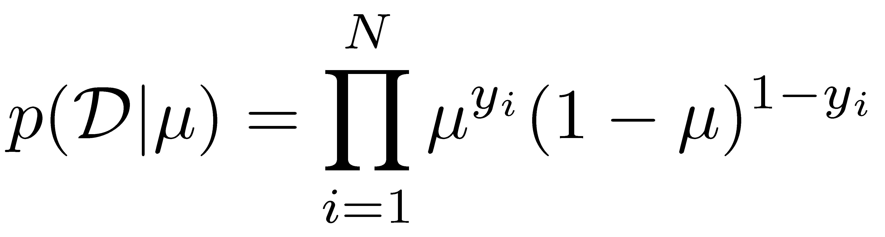
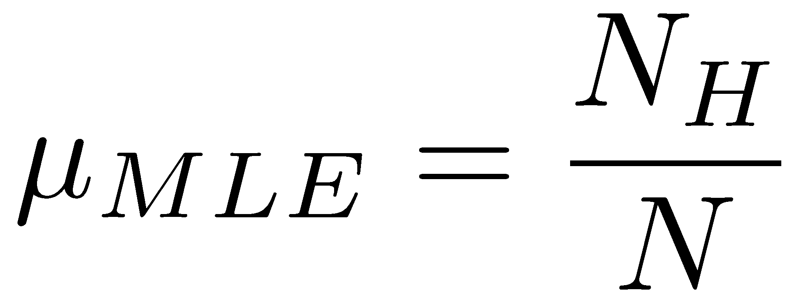
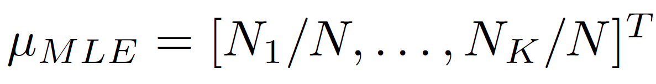
Parameter estimation
Bernoulli distribution
Coin toss experiment: what’s the underlying probability of Heads?
Data likelihood:
MLE: OVERFIT REGULARIZATION
Categorical distribution
MLE:
Relation to classification
Binary: for each x, the class y(x) is modeled with a separate Bernoulli
Multi-class: for each x, y(x) is modeled with a separate categorical
Notes:
Let’s start with a coin toss experiment: we toss a coin N times and based on the results we ask the simple question: is this a fair coin? If not, what’s the underlying probability of Heads?
We model this binary variable with a Bernoulli distribution we write down the data likelihood and then use maximum likelihood estimation (MLE). By doing so we estimate the underlying probability with the sample mean: number of heads divided by total number of samples. What happens however if by chance we observe 3 heads in 3 coin tosses? Then we predict that with 100% certainty the next coin will come Heads too! This is an extreme case of overfitting and we may use regularization to address this issue.
The case is similar for the categorical distribution which is used to model variables that can take more than 2 discrete values. It is just a generalization of Bernoulli so you may see it as Multinoulli in the literature. And as you can see the MLE for categorical is very similar to the one for Bernoulli, the vector of probabilities is just a vector of the sample means.
Now, why do we say all that? The reason is that in binary classification we model the class y(x) as the outcome of a Bernoulli experiment, the parameter of which we try to estimate. Note that it’s a separate Bernoulli distribution for each x, which simply means that each x (say each image) has a different probability of belonging to each class. Similarly, for multi-class classification we model each y(x) with a separate categorical distribution.

Slide 5
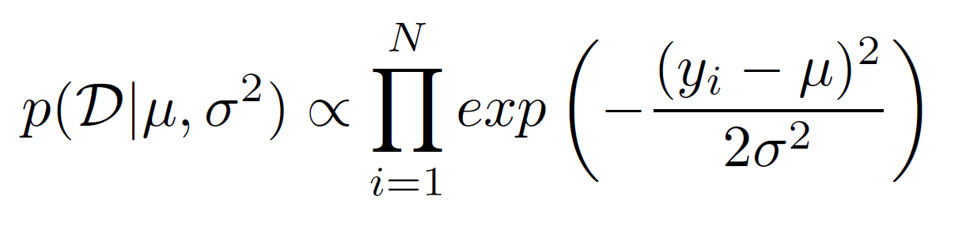
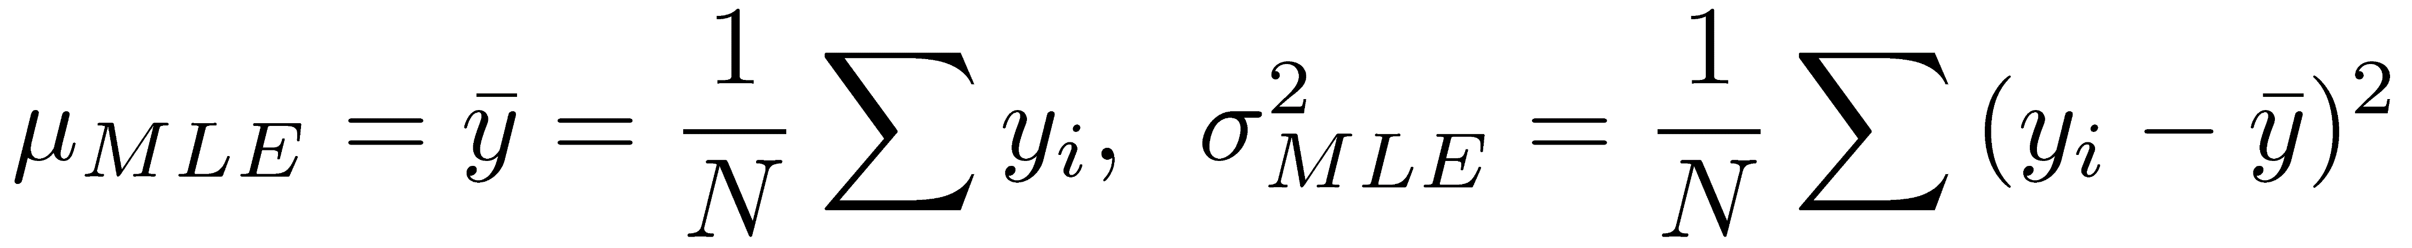
Parameter estimation
Gaussian distribution with unknown mean and variance
Data likelihood:
MLE:
Relation to regression
For each x, y(x) is modeled with a separate Gaussian
Notes:
Let’s see what’s the case for a Gaussian distribution with unknown mean and variance. Again, we assume that we have independent samples from a Gaussian, we can write down the likelihood of the data (it’s just a product of the likelihood of each datapoint) and use MLE for obtaining estimates for the mean mu and variance sigma squared.
We use this problem here as introduction because in regression we model each y(x) with a separate Gaussian distribution with separate mean and variance that we try to estimate.

Slide 6
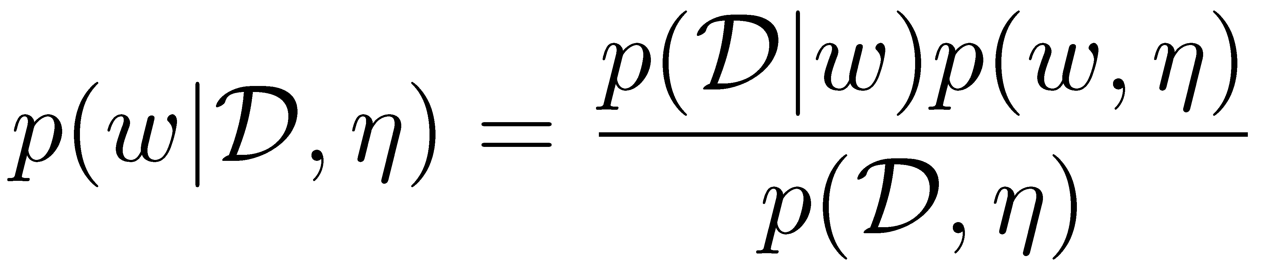
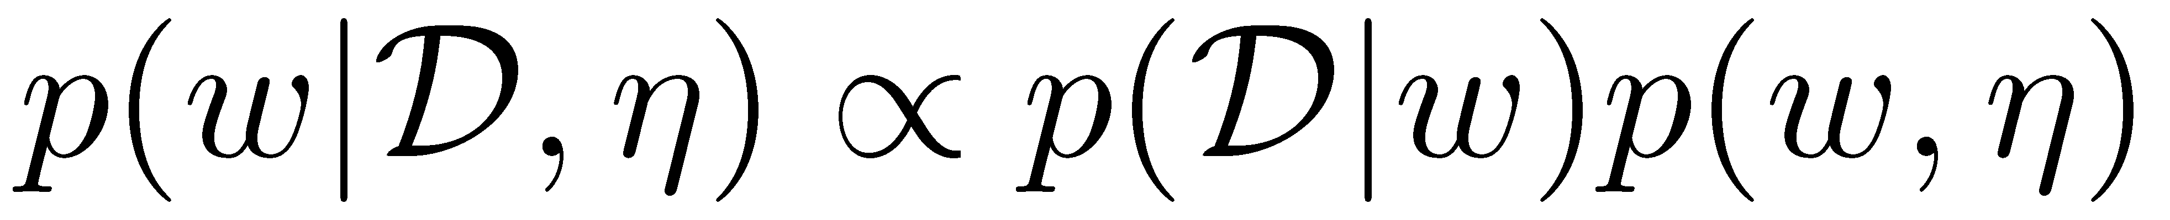
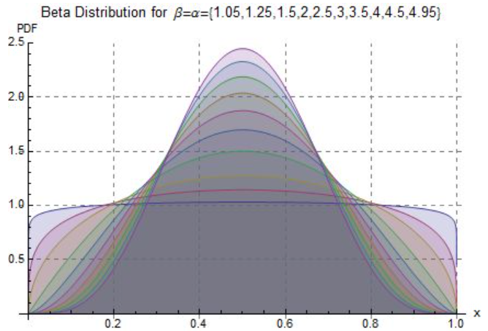
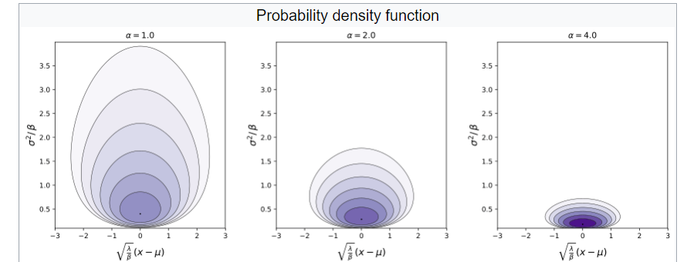
Parameter estimation
Bayesian inference
MLE & regularized MLE (aka MAP) provide point estimates
Posterior distribution: how probable is that w produced the data?
Conjugate priors: prior and posterior same functional form!
True for exponential distributions: Bernoulli, categorical, Gaussian
Nothing more than e^{x} e^{y} = e^{x+y}
Prior-likelihood conjugate pairs:
Beta prior Bernoulli likelihood Beta posterior
Dirichlet prior Categorical likelihood Dirichlet posterior
Normal-Inverse-Gamma (NIG) Gaussian NIG
Analytical posterior!
Notes:
Further, because MLE, even if regularized to address overfitting, provides only point estimates, we can use Bayesian inference for estimating uncertainty.
Remember we are still in the parameter estimation setting so let’s forget for now about NNs, NN priors etc.
In Bayesian inference we define a posterior distribution which represents how probable is that some parameter w produced the data we have observed. W here refers for example to the Bernoulli probability parameter or the mean and variance of the Gaussian distribution. As you can see the posterior is proportional to the likelihood that we defined earlier, times the prior of w. The prior is just a probability distribution for the parameters w parametrized by eta.
How can we take advantage of this proportionality? It would be ideal if we defined a prior that interacts in an analytically convenient way with the likelihood. This is the case, for example, for conjugate priors which are defined in such a way, so that the posterior has the same functional form as the prior.
Interestingly, it is straightforward to define such a prior for members of the exponential distribution family, and it is convenient that all of the distributions that we’ve talked about so far, Bernoulli, categorical and Gaussian all belong to the exponential family.
So by using analytical derivations as simple as this property of exponential functions, we can define prior-likelihood conjugate pairs. In other words, given the functional form of the likelihood function we can find what type of prior behaves in this convenient manner. For example, for a Bernoulli likelihood, the conjugate prior is the Beta distribution and therefore the posterior is also a Beta distribution.
For a categorical likelihood the conjugate prior is a Dirichlet distribution (a generalization of Beta) and for a Gaussian likelihood it’s the Normal–inverse gamma.
Overall, the thing to remember here is that by selecting an appropriate functional form for the prior we can have the posterior in an analytical form.

Slide 7
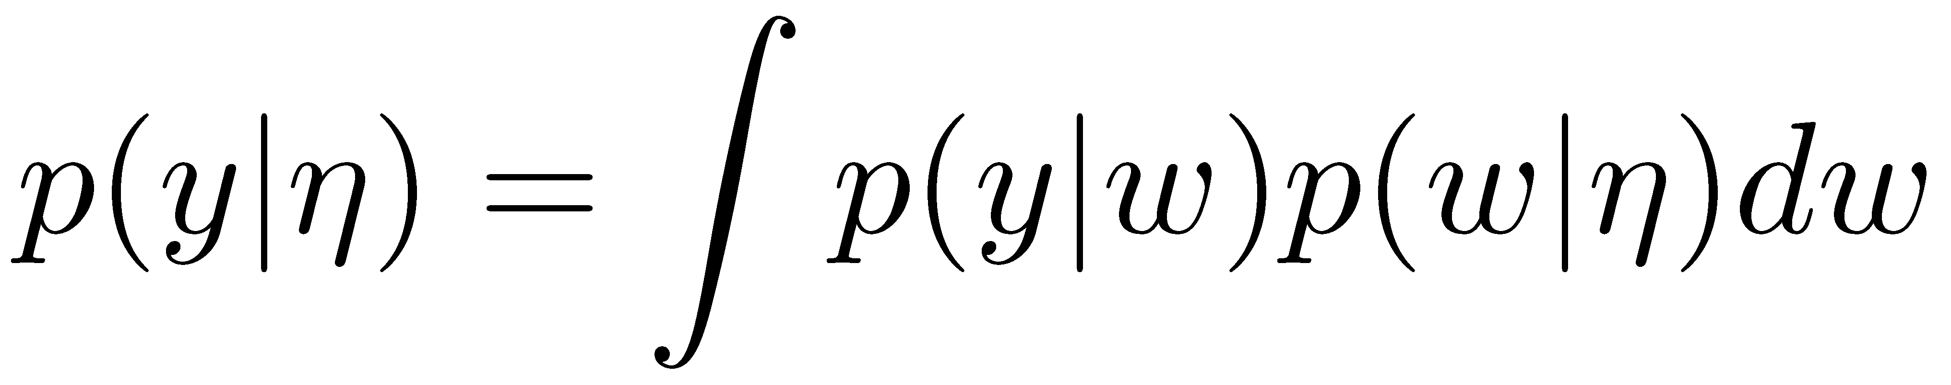
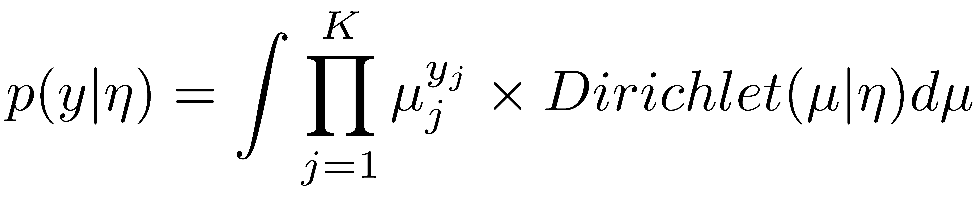
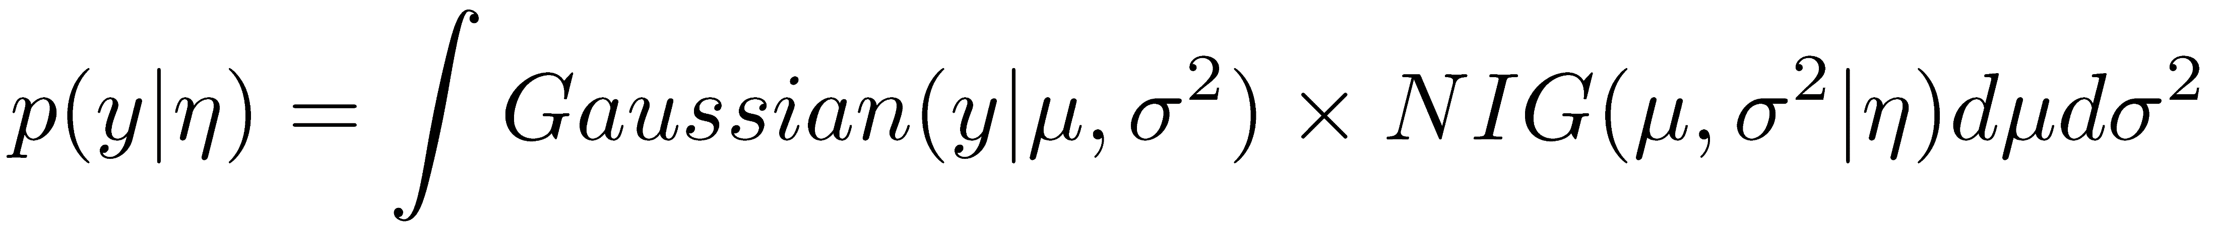

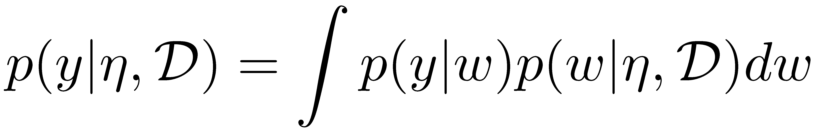
Parameter estimation
Prior predictive distribution:
Probability of observing a y value based only on prior
Posterior predictive distribution:
Probability of observing a y value based on prior + data
Student’s-t distribution(η)
Same analytical
expressions!
Notes:
The discussion up to now was related to how to estimate the underlying parameter of the distribution. For example, inferring the mean of the Gaussian that has produced the datapoints that we have observed.
Now, we can discuss about making predictions based on the inferences we have made.
Before we see any data, we can only make predictions using the prior predictive. This corresponds to the average likelihood over all the values w can take.
To put it simply, we use the likelihood of y given w, but we marginalize all the possible w values. And these possible w values are defined by the prior. Also, as you can see the predictions y are only based on eta which parametrizes the prior.
If we decide to use a conjugate prior as discussed in the previous slide, we can perform this integration analytically: For example, the prior predictive for a categorical distribution is given explicitly from the hyperparameters eta of the Dirichlet prior and for the Gaussian it is given by a Student’s-t distribution with again hyperparameters eta.
After we observe the dataset D, we can use the posterior predictive which also marginalizes the w parameters of the likelihood by using the posterior. As you can see the two predictive distributions are very similar. It’s an integral of the likelihood times either the prior or the posterior. But we have already said that the prior and the posterior have the same functional forms! So the same analytical expressions we have for the prior predictive apply for the posterior predictive as well. The difference is that in the posterior predictive there is also a dependence on the data too, not only on the prior hyperparameters eta.

Slide 8
Parameter estimation
Implications of conjugacy:
The posterior predictive can be construed as a prior predictive with better-informed hyperparameters
These hyperparameters depend on:
Prior hyperparameters
Data - evidence
Prior hyperparameters: “pseudo-evidence”
α, β in Beta prior: α Heads and β Tails in α+β fictitious observations
γ, v, α, β in NIG:
v fictitious observations with sample mean γ
2α fictitious observations with sum of square residuals 2β
General result for exponential distribution
Hyperparameters corresponding to fictitious observations
Notes:
We have seen that the prior predictive and the posterior predictive have the same functional form. And this is because we selected a conjugate prior.
We can therefore interpret the posterior predictive as a prior predictive, but with better-informed hyperparameters, which depend on the respective ones of the prior but also on the acquired data, the evidence in other words.
For example, imagine making sequential predictions as new data continuously arrives: we start with a prior, after the first data arrives this becomes a posterior, and then this posterior is used as a prior for the new data.
Following the same line of thought, but doing the inverse, we can see the prior predictive as a posterior predictive with fictitious observations. For example, the alpha and beta hyperparameters in the Beta prior can be seen as alpha Heads and beta Tails in alpha plus beta fictitious observations. Similarly for the normal-inverse-gamma prior and similarly for any exponential distribution. Hyperparameters can be interpreted as corresponding to fictitious observations.

Slide 9
Parameter estimation
Why the introduction?
Suppose we have no data: no access to posterior predictive
But somehow have good prior hyperparameters
Then prior predictive can be as accurate!
Suppose a NN outputs these hyperparameters
It is as if the NN produced fictitious evidence!
In evidential classification/regression a NN produces good hyperparameters for each x and a prediction is made using the prior predictive
Which we have analytically!
Notes:
And now I will explain why I have made this lengthy introduction although we may not care about parameter estimation but care about regression instead.
Consider the extreme scenario that we have no data and thus no access to the posterior predictive. But somehow we have good prior hyperparameters. Then the prior predictive can be as accurate as the posterior predictive and this depends on how informed the hyperparameters are.
Suppose now that these hyperparameters are the output of some NN. We can metaphorically say then that this NN produced evidence, in other words produced equivalent fictitious observations.
Once again note that prior hyperparameters are interpreted as equivalent evidence.
And here is the main point: in evidential classification and regression a NN produces good hyperparameters for each x (different for each x) and a prediction is made via the prior predictive. Which we have in an analytical form as we mentioned earlier. It’s a Student’s-t distribution for regression.
So after introducing some important terminology, such as conjugate priors, prior and posterior predictive and fictitious evidence, let’s talk specifically about supervised learning.

Slide 10
Classification/Regression
Binary classification
Likelihood function for each x:
Categorical distribution for multi-class
Given x, NN outputs μ_{w}(x)
Softmax “squashes” the continuous output into a unit simplex
Single prediction: Class corresponding to max(μ_{w}(x))
Regression
Likelihood function for each x:
Given x, NN outputs μ_{w}(x) (or also σ_{w}(x))
Single prediction: μ_{w}(x)
MLE, regularized MLE (MAP), Bayesian approaches, etc.
Classification MLE: cross-entropy loss
Regression MLE: sum of squared errors loss
We optimize (or sample) w and then use likelihood function to make predictions
Notes:
For a probabilistic view of supervised learning we select a likelihood function to describe the value y(x) for each x.
For example, the likelihood function for binary classification is given by the Bernoulli distribution with a parameter given by an approximator, such as a NN.
Just to clarify, in the parameter estimation problem we’ve been talking about so far, we denote with w the parameter of the one Bernoulli distribution we are trying to estimate, whereas in the binary classification problem we denote with w the NN parameters that output the Bernoulli distribution parameter for each x. I hope this is not confusing.
For multi-class classification we use a categorical distribution instead of a Bernoulli one.
In both cases, given input x, a NN outputs mu_w of x (the vector of discrete probabilities). To do that we just use a softmax output activation function that squashes the continuous output into a unit simplex. This simply means the vector sums to 1. And if we want to make a prediction we can just select the class corresponding to the max probability in the vector mu_w.
For regression, the likelihood function is given by the Gaussian distribution with mean given by an approximator, such as a NN.
The aleatoric uncertainty sigma squared can either be considered as a hyperparameter (I won’t discuss in this presentation how to tune it) or as part of the output of the NN as well; this is the sigma_w squared you see here.
If we want to make a single prediction for a given location x, we can just use the mean that is given as output from the NN.
In terms of optimizing our NN, we can compute the likelihood of all the data and perform MLE.
For example, for classification MLE corresponds to minimizing the well-known cross-entropy loss and for regression the sum of squared errors.
Alternatively, we can perform regularized MLE (also known as maximum aposteriori estimation for certain cases), or use Bayesian approaches. Of course there are other approaches too.
In all these cases, we optimize or sample the NN parameters w, and then use the likelihood function to make predictions. The likelihood functions are highlighted with red color for each case.

Slide 11
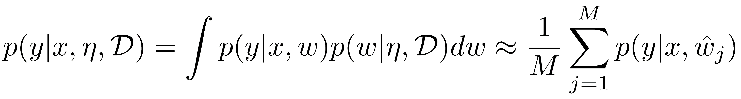
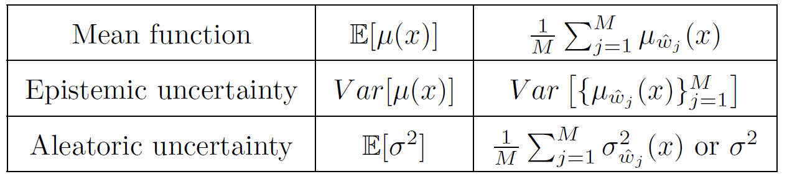
Classification/Regression
Bayesian treatment
Posterior distribution:
Making predictions
We use the likelihood function with different w samples
Notes:
Let’s take for instance the Bayesian treatment of the learning problem. We define the posterior; remember here this is a posterior with respect to the NN parameters, not the likelihood fnction parameters, and for making predictions we can use a Monte Carlo estimate and average many different predictions with w_hat being samples from the posterior.
I also won’t talk in this presentation about how to do posterior sampling.
The point that I would like to get across, however, is that we make predictions by using the likelihood function with multiple values for the NN parameters w.
We also have an interpretation of our results: remember the NN outputs mu_w(x), for regression this is the mean of a Gaussian at x. Therefore, by averaging many predictions we estimate the average value of this mean. Further, by computing the variance of these outputs, we have an estimate of the variance of the mean; this is a measure of epistemic or model uncertainty. You can see it this way: we have assumed a Gaussian model for each x. The mean for this Gaussian is given by a NN. But how certain are we for this predicted mean? Different NN parameter values w correspond to different predictions for the mean and different mean values correspond to a different Gaussian likelihood functions. This is what we call model uncertainty and this uncertainty is different for each x.
In terms of aleatoric uncertainty, this is the variance of the assumed Gaussian, we either set it as a hyperparameter and estimate it differently or it’s also output of the NN and therefore we can take its average value as well.

Slide 12
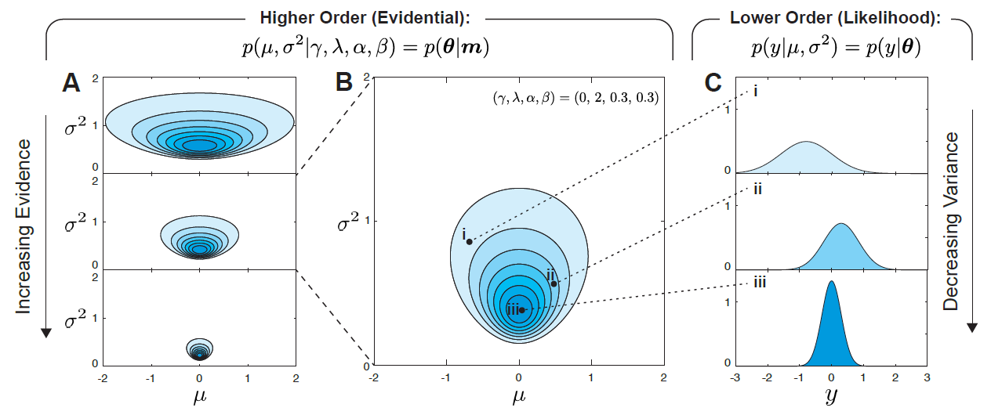
Classification/Regression
Evidential treatment
Prior predictive instead of likelihood for predictions
Higher-order distribution that already includes uncertainty
Fit η instead of likelihood parameters
Prior hyperparameters being fitted have nothing to do with Bayesian NN prior!
Notes:
We saw in the previous slides that standard training of NNs and Bayesian sampling have a basic similarity: both use the likelihood function for predictions.
In the evidential framework we use the prior predictive instead. Recall that we have it in an analytical form for the basic likelihoods we have discussed about.
We can construe the prior predictive as a predictive function that already takes into account epistemic uncertainty by having already integrated over all the possible likelihood parameter values. Consider this figure for example. In part A we see different priors for the mean and the variance. More fictitious evidence corresponds to less uncertainty, or in other words to a more concentrated prior. In part B we see a specific prior, say one of the three priors we see in part A. A pair mu, sigma squared from this prior corresponds to different likelihood functions shown in part C. So the prior predictive marginalizes over all these local likelihood functions shown in part C and gives a prediction that depends only on the prior hyperparameters eta.
Next, since we make predictions using the prior predictive, we train a NN to output the eta parameters of the prior predictive, instead of the likelihood parameters.
As a reminder, I’m again noting here that the prior hyperparameters being fitted have nothing to do with the Bayesian NN prior. In fact we will use a deterministic NN for this job, so there are no priors in the NN level.

Slide 13
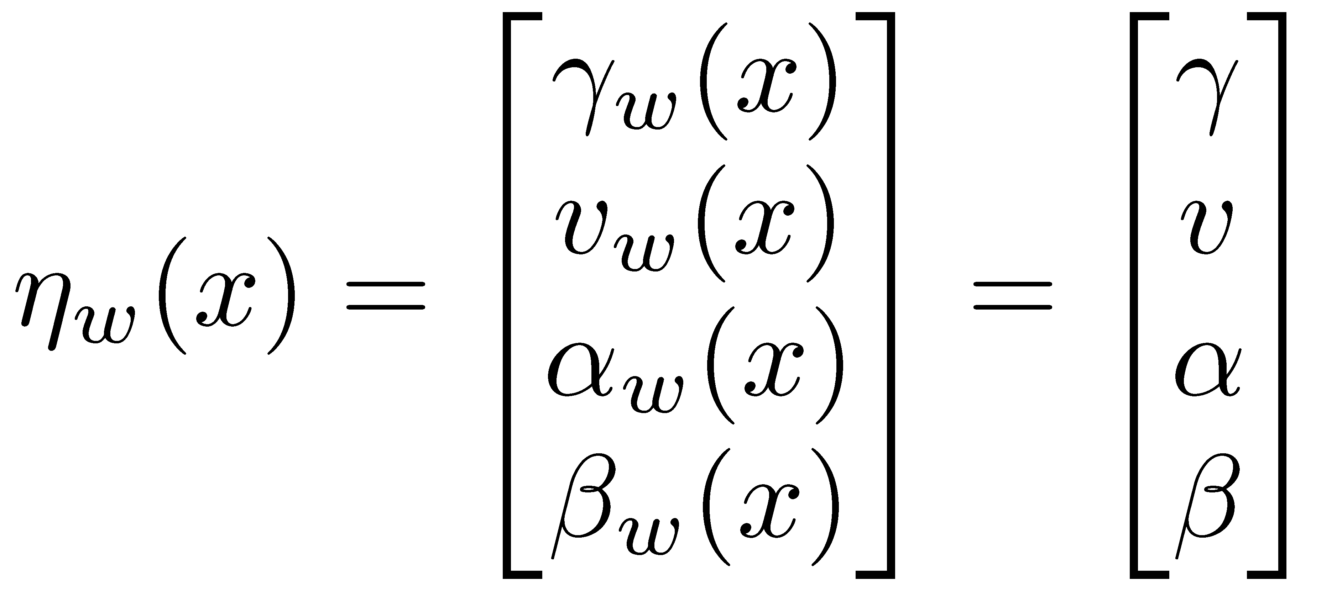
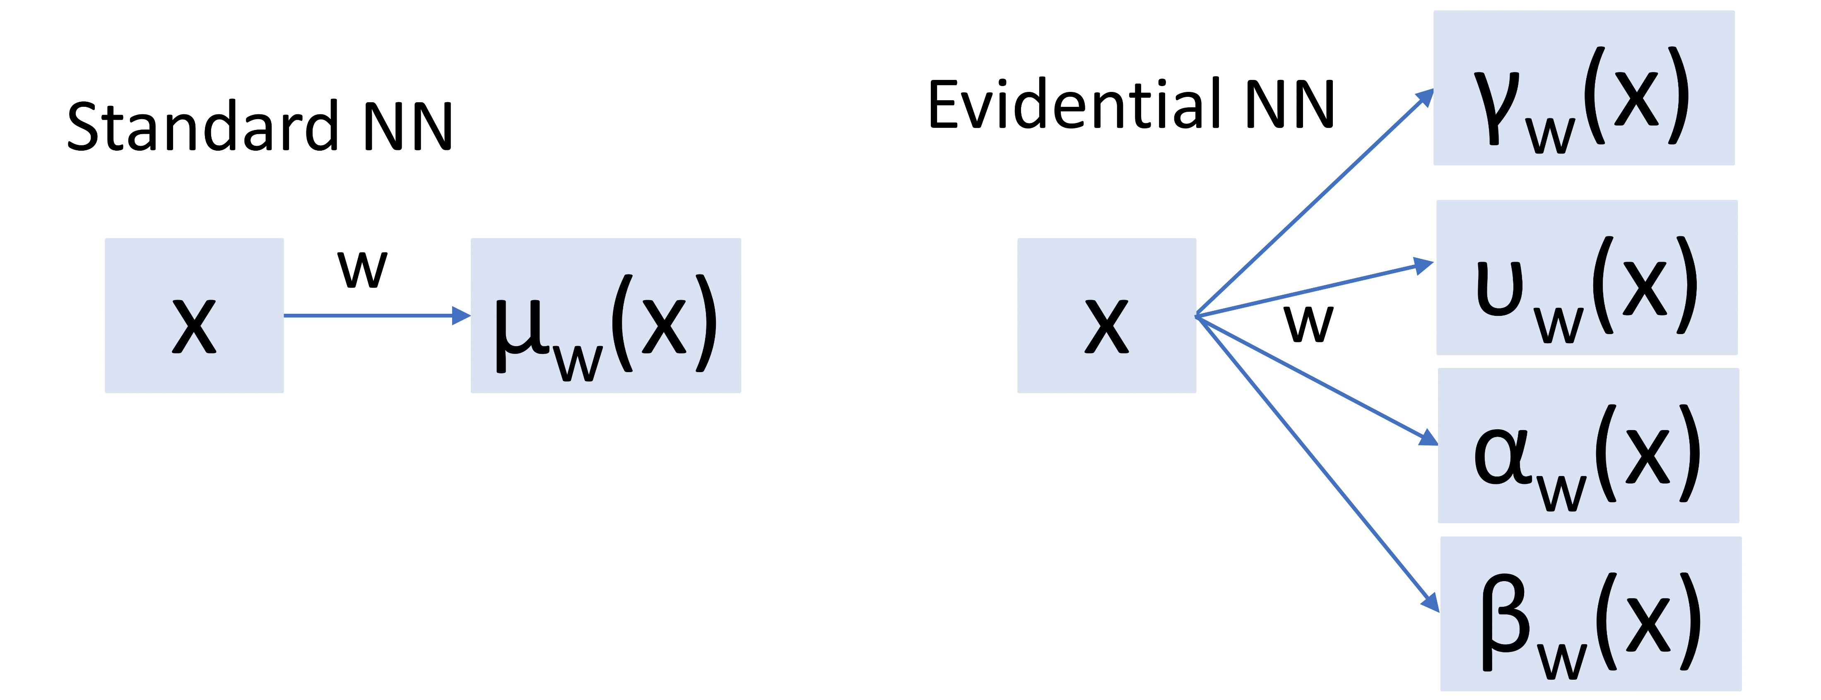
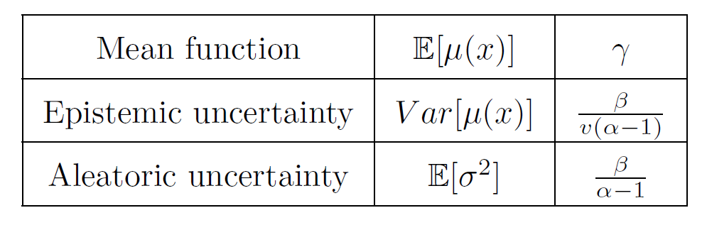
Classification/Regression
Evidential treatment: Making predictions in regression
Prior predictive for regression is a Student’s-t with hypers η(x)
Instead of fitting the likelihood mean we fit the prior hypers
Comparison with standard NN
Uncertainty with a single w!
Notes:
We’ll discuss next more specifically about evidential regression. As mentioned earlier, the prior predictive for regression is a Student’s-t distribution parametrized by eta(x). These are the prior hyperparameters. So in evidential regression we fit with a NN the prior hyperparameters instead of the likelihood mean.
In this regard, the prior is a Normal-inverse-gamma distribution with 4 hyperparameters and these same 4 parameters are transferred to the prior predictive which is a Student’s–t distribution. Thus, we use a NN as a map from the location x to these 4 hyperparameters. And here you can visualize the difference with a standard regression NN.
This 4-dimensional output has the following interpretation. The gamma parameter corresponds to the mean value for the location x, beta divided by v times alpha minus 1 represents the variance of this mean value, this has to do with epistemic uncertainty, and beta divided by alpha -1 is interpreted as aleatoric uncertainty. These results are easy to derive analytically using the normal-inverse gamma prior given these 4 hyperparameters.
As you can see, using a deterministic NN and only one forward pass we have also uncertainty estimates!

Slide 14
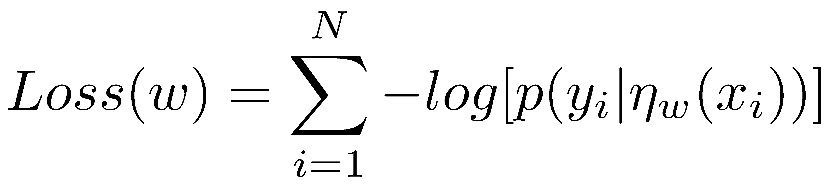
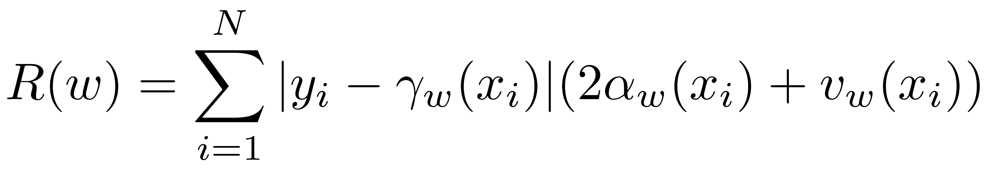
Classification/Regression
Evidential treatment: Training in regression
Loss function: we can construe prior predictive as a different likelihood
Similar to marginal likelihood (marginalized parameters)
MLE:
Regularization – Desired properties:
Larger penalty for larger data misfit
Larger penalty for larger fictitious evidence
Larger fictitious evidence in the prior, less uncertainty
We want the model to output large uncertainty if it is not sure
“Sure” means small data misfit
γ, v, α, β in NIG:
v fictitious observations with sample mean γ
2α fictitious observations with sum of square residuals 2β
Notes:
Let’s see how to train this NN now. I think a convenient way to interpret the prior predictive is as a different likelihood function. Because it is the result of an integration over all w parameters, in other words a marginalization, it is usually called a marginal likelihood. But this is not so important right now. What is important is that if we see it as a different likelihood function, we can define a loss function using the negative log likelihood on the data. Just the sum of all the negative log –marginal- likelihoods. This is usually called type-II MLE because we use the marginal likelihood.
In terms of regularization, of course we can always use weight decay or some other regularization targeting the NN weights. But we may be able to do something smarter.
Consider two desired properties of the regularized for this case: We want it to apply larger penalty values for larger data misfit and larger penalty values for larger fictitious evidence.
In other words, we penalize the NN for leaving the uncertain state, the I do not know state. Recall from our discussion earlier that larger fictitious evidence in the prior corresponds to less uncertainty. We want the model to output large uncertainty if it is not sure, where sure in this case means small data misfit.
In the evidential regression paper, they propose to use a regularizer given as the product of data misfit and produced evidence. And in order to define how much evidence is produced we recall that in the normal-inverse prior the hyperparameter v can be construed as v fictitious observations with sample mean gamma and the alpha hyperparameter as 2a fictitious observations with sum of square residuals 2 beta.
Also you can see in the table of the previous slide, that large v and alpha values correspond to less epistemic uncertainty. If small epistemic uncertainty is produced, we want it to be supported by very low data misfit. That’s how they define their regularizer.

Slide 15
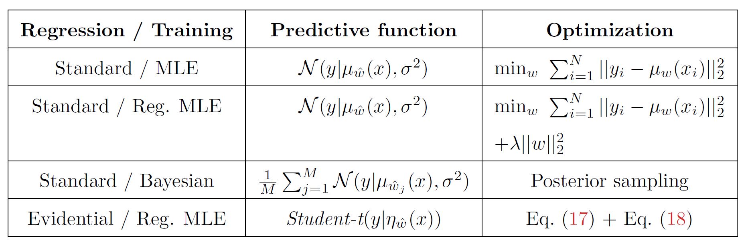
Classification/Regression
Evidential treatment: Summary for regression
Notes:
To summarize what we’ve been discussing so far, consider this table.
In standard regression trained with MLE, we use a Gaussian likelihood predictive function with mean given by a NN. And we minimize the sum of squared errors in order to optimize the NN parameters.
For regularized MLE the same holds, but we train with an additional penalty.
Still in standard regression but within the Bayesian framework, we use the same Gaussian predictive function but with means produced by different NN outputs. We obtain the different NN parameters through posterior sampling.
Finally, in evidential regression, the predictive function is a student’s t distribution with 4 hyperparameters given by a NN. We train the NN with regularized MLE. The regularization is defined by penalizing the NN for leaving the uncertain state.

Slide 16
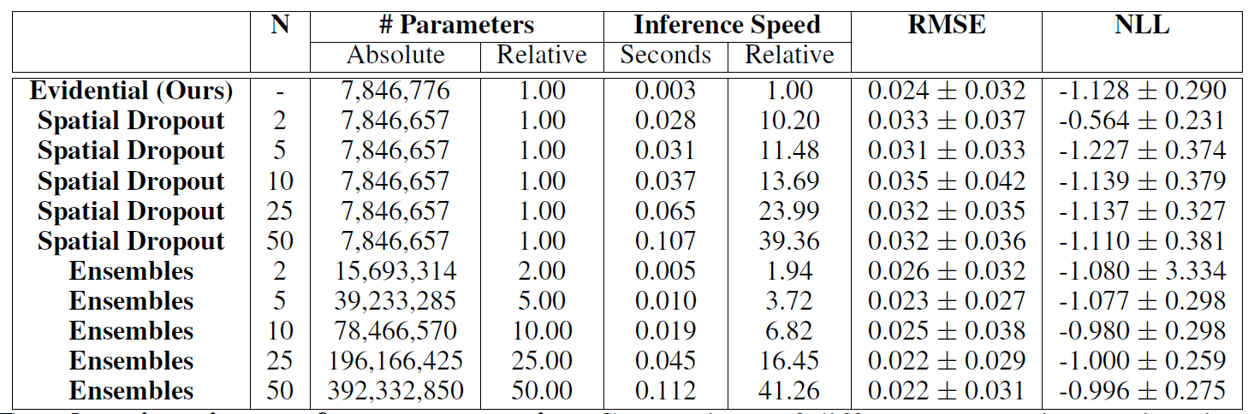
Key points through examples
Evidential regression does not rely on sampling during prediction
Faster!
Notes:
In order to draw some conclusions and possibly better understand a few details, we will go through some tables and graphics from the deep evidential regression paper. In this slide we will only talk about prediction speed; this means how fast for a new x we the technique can provide uncertainty estimates. Here it is referred to as inference speed. So let me hide the unrelated panels.
First, we use an evidential NN that as we said provides uncertainty with a single forward pass. For a new x location it takes .003 seconds to output its prediction. On the other hand, by training separately 2 NNs (you may have seen this approach referred to as deep ensembles) we spend double time to make predictions because we need to do 2 forward passes. And this time goes up linearly as we use more samples. So the uncertainty quality depends on the number of samples, although typically 5 to 10 samples in the ensemble are sufficient.
The situation is similar with dropout. Although training is as cheap as using a standard NN, there is some overhead for sampling a different mask for the weights and then some computational cost for making multiple forward passes.
Overall, during prediction evidential regression is much faster than sampling approaches, although this prediction cost is often not very important in practice as compared with training cost.

Slide 17
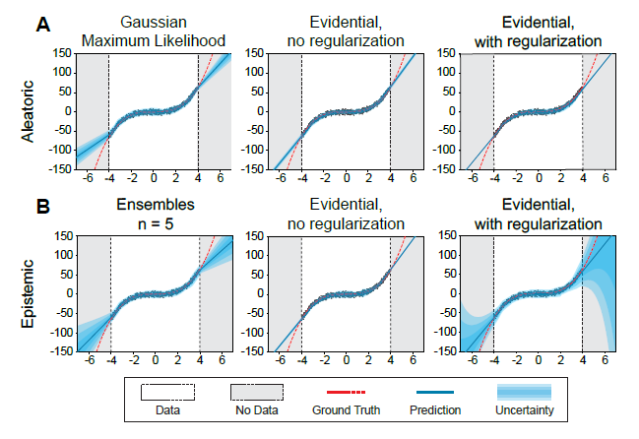
Key points through examples
Predicted epistemic uncertainty depends highly on the regularization parameter
Aleatoric does not
Notes:
Another key point is that the predicted epistemic uncertainty depends highly on the regularization parameter.
In the top panels you can see the aleatoric uncertainty predicted by Gaussian MLE (on the left), evidential regression with no regularization (in the middle) and evidential with regularization on the right. Aleatoric uncertainty does not depend that much on regularization.
On the other hand, in the bottom panels you can see the epistemic uncertainty predicted by Deep ensembles and evidential regression. By comparing the middle and the right graphs we can see that epistemic uncertainty predicted by the evidential NN depends highly on the regularization parameter.

Slide 18
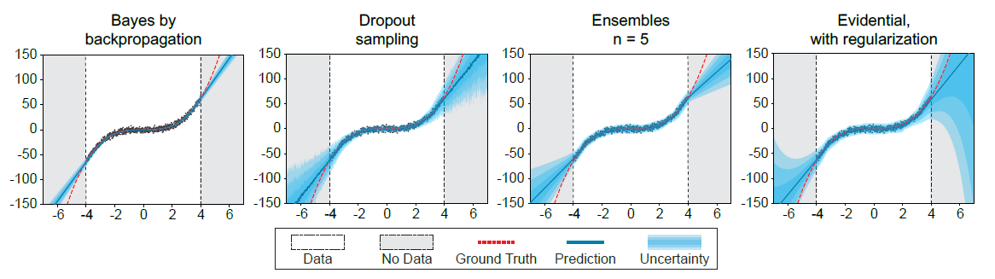
Key points through examples
With the right regularization evidential regression can give competitive results for out-of-distribution epistemic uncertainty
Notes:
With this figure, I would like to demonstrate that evidential regression with the right amount of regularization can compete with other Bayesian or non-Bayesian techniques. For example, here we consider bayes by backprop (this is variational inference), dropout sampling, deep ensembles and evidential regression.
At least for this example, for regions with no observed data (these are the gray regions) evidential regression produces large uncertainty as it should. And the uncertainty quality seems to be much better than the rest.

Slide 19
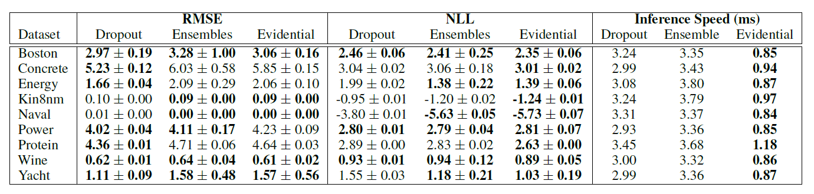
Key points through examples
Evidential regression is competitive both in terms of accuracy (RMSE) and uncertainty estimation (negative log-likelihood; NLL)
Notes:
Next, the authors of the deep evidential regression paper show that their evidential regression technique outperforms dropout and deep ensembles for many real-world benchmark regression tasks (shown in the very left column).
For example, it outperforms them in terms of uncertainty quality, this is measured with negative log likelihood on test data, and is competitive in terms of root mean squared error.
We can conclude therefore, that it is a much cheaper approach for producing uncertainty estimates without compromising accuracy.

Slide 20
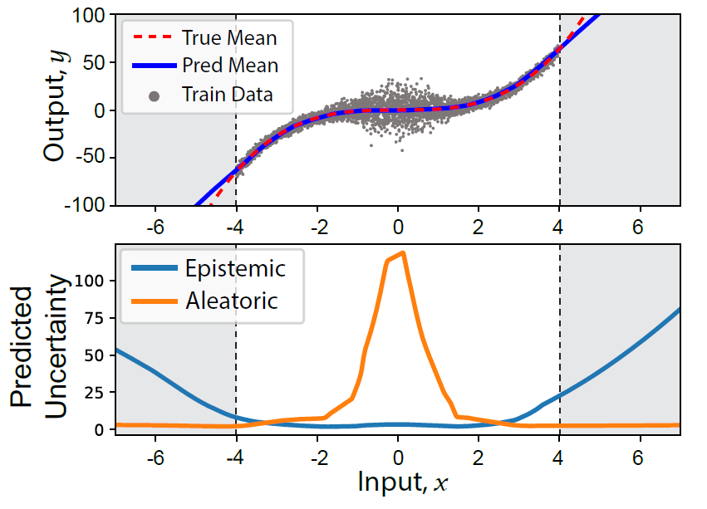
Key points through examples
Evidential regression effectively disentangles epistemic and aleatoric uncertainties
Notes:
Finally, and I think this is important, recall that with a single forward pass the evidential NN produces epistemic and aleatoric uncertainty estimates. To test its behavior, the authors create a cubic function dataset with more noise towards the middle of the region. As you can see, the predicted aleatoric uncertainty (shown with the orange line) is indeed increasing towards the middle as it should, whereas the predicted epistemic uncertainty (shown with blue) increases in the regions where no data was observed for training, that is the gray regions. Again as it should. We see therefore that evidential regression effectively disentangles epistemic and aleatoric uncertainty.

